Slide 1
Digital Differential Analyzer (DDA)
LINE DRAWING ALGORITHM
WITH SOLVED EXAMPLES

Slide 2
DDA LINE DRAWING ALGORITHM
The line (vector) generation algorithms which determine the pixels that should be turned ON are called as digital differential analyzer (DDA).
It is one of the technique for obtaining a rasterized straight line.
This algorithm can be used to draw the line in all the quadrants.

Slide 3
DDA ALGORITHM
Assumption:
(x1, y1) and (x2, y2) are the two end points of a line and are not equal.
Floor integer function is used to convert the real values into integer value.
e.g.: if value is +8.5 then it is converted to 8 and
if value is -8.5 then it is converted to 9.
3. Sign function is used which returns +1, 0, -1 for the arguments >0, =0, <0.
e.g.: sign(5) = +1
sign(0) = 0
sign(-1) = -1
sign (1) = 1

Slide 4
CONTD….
Step 1: Approximate the line length
if abs(x2-x1)>= abs(y2-y1) then
length = abs(x2-x1)
else
length = abs(y2-y1)
end if
Step 2: Decide increment
Δx = (x2-x1) / length
Δy = (y2-y1) / length

Slide 5
CONTD….
Step 3: Decide flow (round the values rather than truncate to handle central pixel addressing correctly)
x = x1 + 0.5 * sign(Δx)
y = y1 + 0.5 * sign(Δy)
Step 4: Begin main loop
i = 1
while (i <= length)
setpixel (intger x, integer y)
x = x + Δx
y = y + Δy
i = i + 1
end while
finish

Slide 6
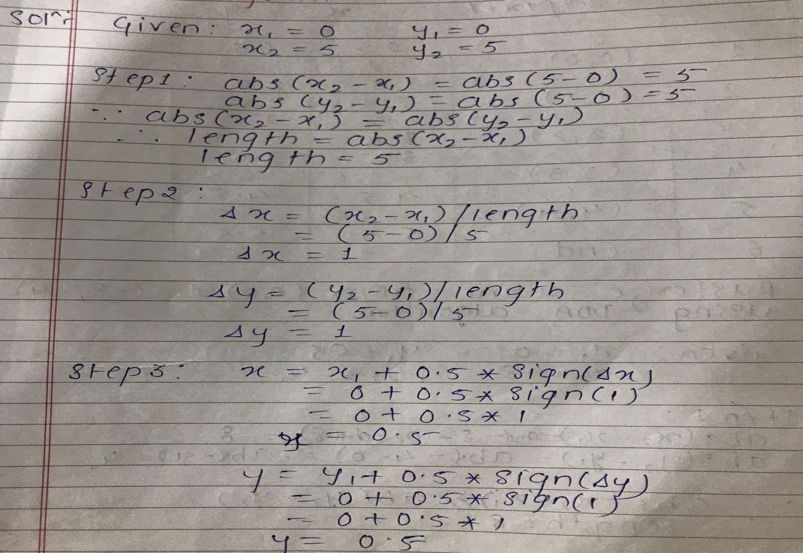
Examples
Q. 1 Rasterize the line from (0, 0) to (5,5) using DDA algorithm.
Solution:

Slide 7
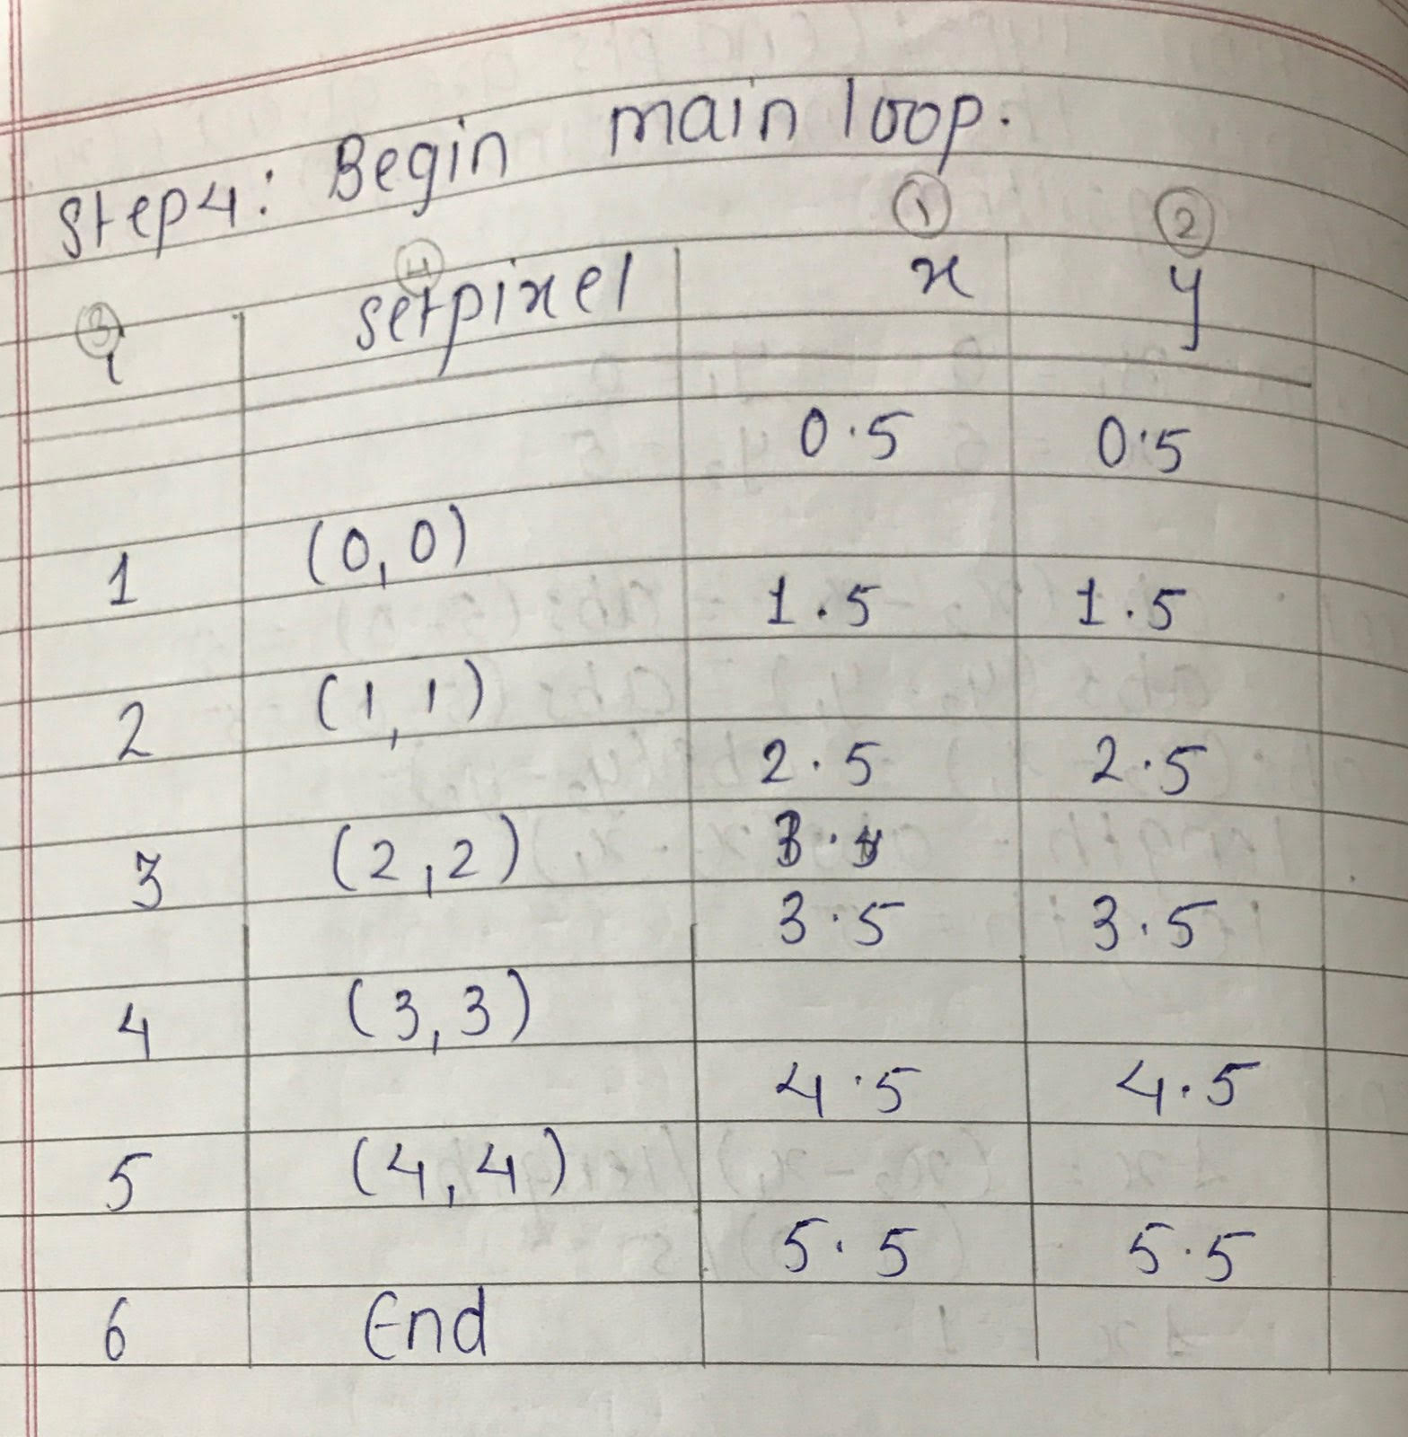
Solution of Q.1 CONTD….

Slide 8
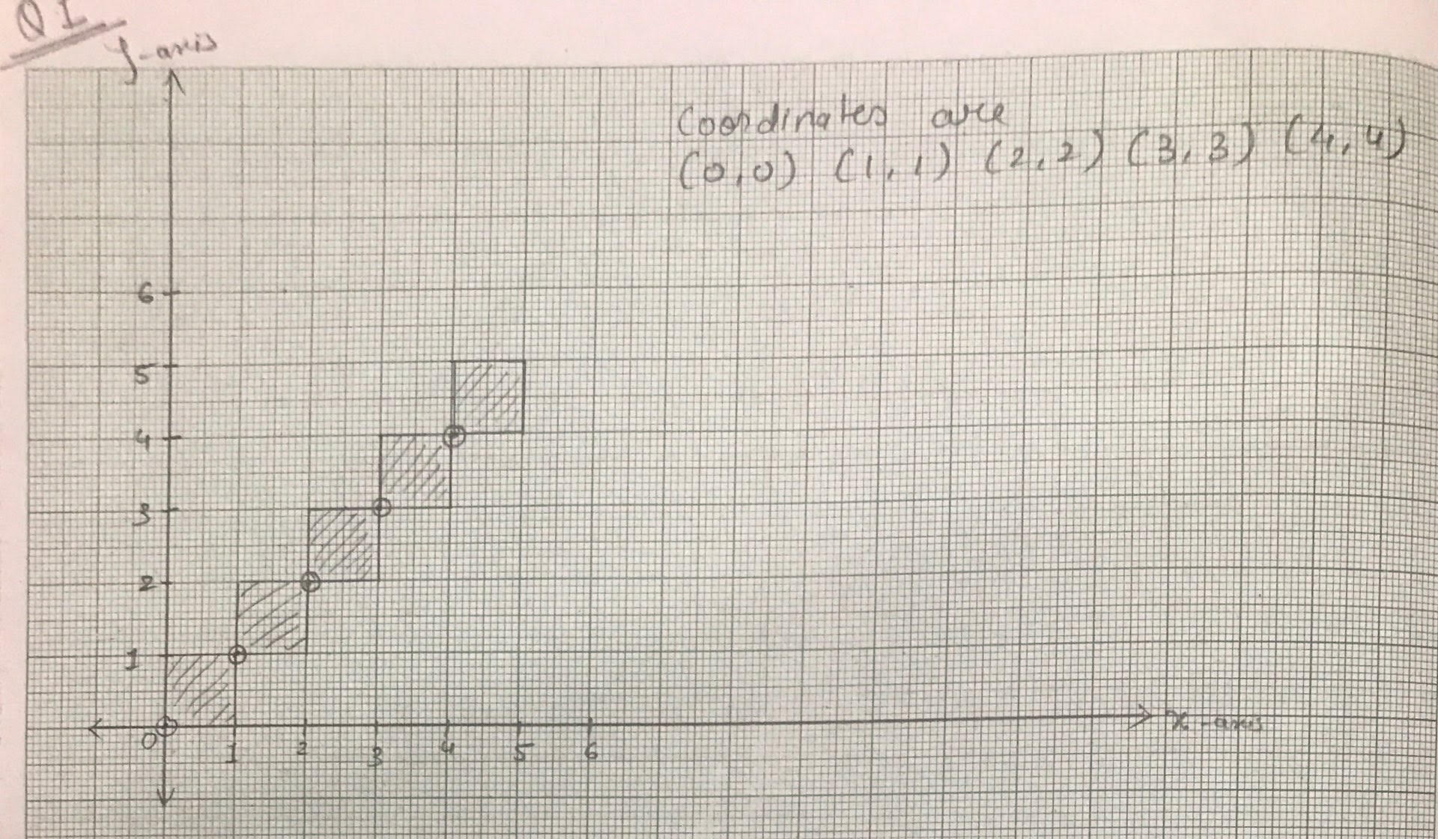
Solution of Q.1 CONTD….
Result :-
The points obtain to rasterize a line from (0, 0) to (5, 5) are :
(0, 0)
(1, 1)
(2, 2)
(3, 3)
(4, 4)

Slide 9
Q2. Rasterize the line from (1, 0) to (5,4) using DDA algorithm.

Slide 10
Note
In Question 1, the end points to draw the line are given directly so, the steps of the algorithm are followed to implement it.
But if the end points are not given and instead the equation is given then first we have to find the end points of a line from that equation and then follow the steps of algorithm.
The procedure is demonstrated in Q.2 by solving the question asked in university paper.

Slide 11
Q. 2 Rasterize the line for the equation
x/2 + y/10 = 1 using DDA line algorithm.
Solution: Given is x/2 + y/10 = 1 --------eq. (1)
Put x = 0 in eq. 1 , then y = 10
the 1st end point (x1,y1) is (0,10)
Put y = 0 in eq. 1 , then x = 2
the 2nd end point (x2,y2) is (2,0)
Here,
x1=0 , y1=10 , x2=2 , y2=0

Slide 12
Solution of Q.2 CONTD….
Step 1: abs(x2-x1) = abs(2-0) = 2
abs(y2-y1) = abs(0-10) = 10
Here, abs (y2-y1)> abs(x2-x1)
length =10
Step 2: Δx = (x2-x1) / length = (2-0)/10 = 0.2
Δy = (y2-y1) / length = (0-10)/10 = -1

Slide 13
Solution of Q.2 CONTD….
Step 3: x = x1 + 0.5 * sign(Δx)
x = 0 + 0.5 * sign (0.2)
x = 0 + 0.5 * 1
 x = 0.5
y = y1 + 0.5 * sign(Δy)
y = 10 + 0.5 * sign (-1)
y = 10 + 0.5 * -1
 x = 9.5

Slide 14
Solution of Q.2 CONTD….
Step 4:
i | Set pixel | x | y
1 | (0,9) | 0.5 | 9.5
2 | (0,8) | 0.7 | 8.5
3 | (0,7) | 0.9 | 7.5
4 | (1,6) | 1.1 | 6.5
5 | (1,5) | 1.3 | 5.5
6 | (1,4) | 1.5 | 4.5
7 | (1,3) | 1.7 | 3.5
8 | (1,2) | 1.9 | 2.5
9 | (2,1) | 2.1 | 1.5
10 | (2,0) | 2.3 | 0.5
11 | END | 2.5 | -0.5

Slide 15
Solution of Q.2 CONTD….
Result :-
10
The points obtain to rasterize a line for the equation
x/2 + y/10 = 1 are :
(0,9)
(0,8)
(0,7)
(1,6)
(1,5)
(1,4)
(1,3)
(1,2)
(2,1)
(2,0)
9
8
7
6
5
4
3
2
1
0
1
2
3
4
5
6

Slide 16
Another Task
Apply DDA algorithm on the following equation:
5x/7 + 18y/7 = 1

Slide 17
Advantages and Disadvantages of DDA
Advantages :
Simplest line drawing algorithm
No special skills required for its implementation
DDA draws the line faster than drawing the line by directly using the line equation.
Disadvantages :
It dependents on orientation which makes the end point accuracy poor.
It requires floating point addition to determine each successive point which is time consuming.
Error due to limited precision in floating point representation may cause calculated points to shift away from their actual position when the line is relatively long.

Slide 18
THANK YOU

